Slide 1

1
2025
Where Should Air Taxis Land?
Finding Optimal Vertiport Locations in Seoul Metropolitan Area with K-Means
INTRODUCTION TO MACHINE LEARNING

Slide 2
2
2025
Chapter
1
4
Project Planning
Modeling
2
5
Data Explanation
Evaluation
3
6
Preprocessing
Conclusion

Slide 3

3
2025
Project Planning
R&R
PM
Modeling Team
Data Team
Planning and managing the overall project
Designing machine learning models and evaluating their performance
Preprocessing data
to improve model performance
Goal: Implement the optimal machine learning model based on the proposed conditions.
Notes:
This project was conducted before clearly assigning the roles and responsibilities, so we started by dividing our team into three main functions:
- the PM, who oversees the overall planning and timeline,
- the Data Team, responsible for preprocessing,
- the Modeling Team, in charge of model development and evaluation.

Slide 4
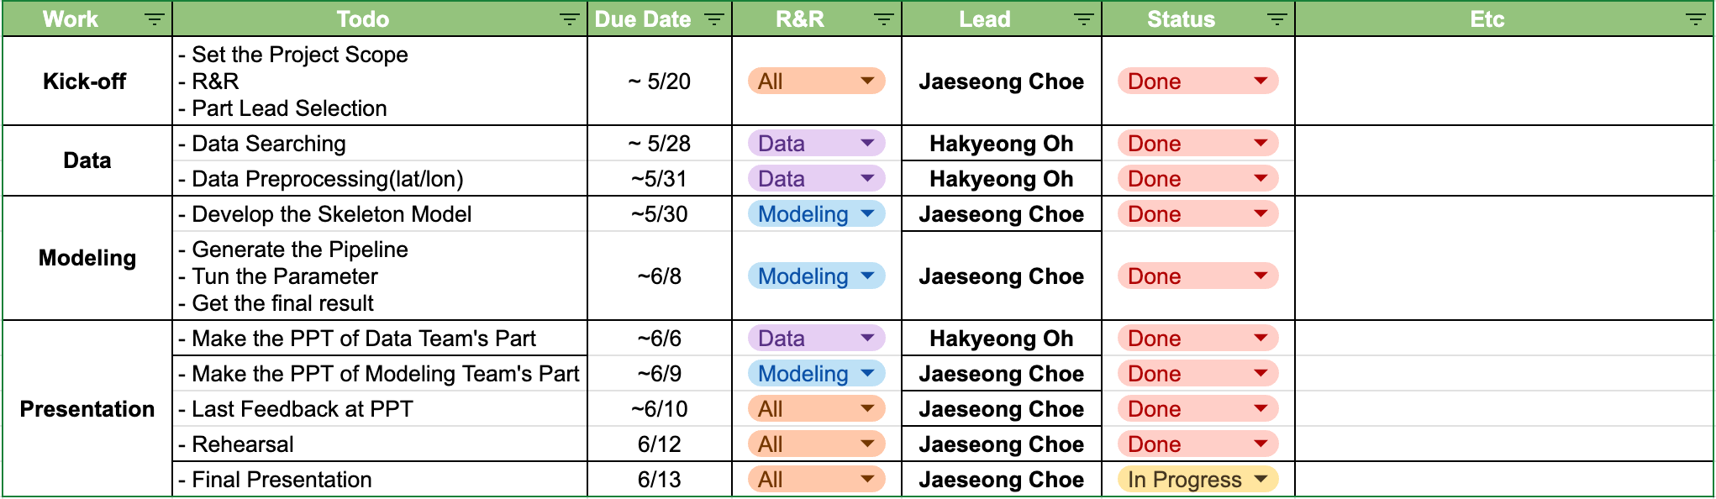
5
2025
Project Planning
Planning
Notes:
As PM, I created an initial timeline and made sure the project progressed in line with our deadline.
We then collaborated closely to ensure each stage—from data preparation to modeling—was completed effectively.
In the following slides, we’ll walk you through our full methodology, including how we prepared the data, designed the model, and evaluated its performance.
Now, Eunhye will begin by presenting the data preprocessing part.

Slide 5
6
2025
Data Explanation
Overall Preprocessing Flow
Organize Data
Define Point Counts
Clean Land Use dataset
Preprocess data using
Excel files and GIS shapefiles
Define point counting by commuting population and worker count each region
Remove restricted zones
Distribute Points
Overlay Dataset
Distribute random points
based on normalized values
Overlay land use data on
metropolitan boundary in GIS
Notes:
Our preprocessing followed five steps: Organize Data, Define Point Counts, Clean the Land Use Dataset, Overlay Datasets, and Distribute Points.
This flow ensured that we could generate spatial points only in valid and meaningful locations, based on both statistical and spatial information.

Slide 6
7
2025
Data Explanation
Data Organization
Data Name | Purpose | Source
Total commuting population | To determine the demand for commuting flows and normalize point distribution across districts | Statistics Korea
Economic Census worker count | To evaluate the density of business activity and allocate points accordingly with appropriate weighting | Statistics Korea
Urban Area Land Use Zone | To filter based on the UQA land use code table, and to exclude restricted areas | V-world (Digital Twin Korea)
Capital region boundary | To define the spatial boundary and limit the analysis and point generation to the capital region | Statistics Korea and MOIS
Notes:
We brought together several data sources:
commuting population
worker statistics
urban land use shapefiles,
And regional economic activity data.
The commuting data helped us understand mobility demand across regions.
The economic census data provided insight into the intensity of business activity, which allowed us to allocate points with appropriate weighting.
And the land use shapefiles allowed us to define areas where it’s physically and legally feasible to generate points.

Slide 7


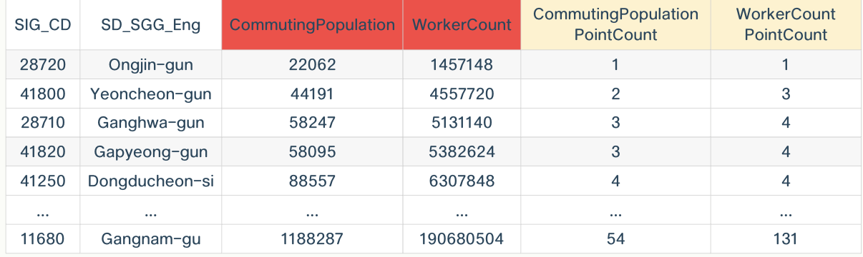
8
2025
Preprocessing
Defining Point Count Standard
Reference Variables:
Method:
Example:
① Total commuting flow
② Economic Census worker count
Minimum reference value
➤ Ongjin-gun
Gapyeong-gun’s commuting volume = 58,095
Ongjin-gun’s commuting volume = 22,062
➤ 58,095 ÷ 22,062 = 2.63 → 3 points assigned
Notes:
We resolved ambiguous region names—for example, "Jung-gu" appears in both Seoul and Incheon.
After that, we standardized regional codes by merging administrative IDs, called SIG_CD, from a reference file.
And finally, we cleaned up the numeric fields, filling in missing values and converting everything into consistent integer formats.
We utilized both commuting volume and worker count, and set Ongjin-gun—the region with the lowest value—as our reference unit, assigning it 1 point.
Then, other regions were assigned points proportionally based on this reference value.

Slide 8


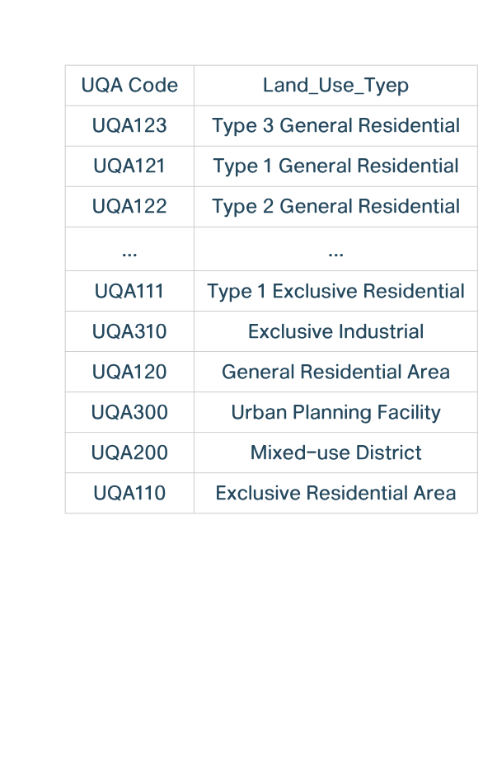
9
2025
Preprocessing
Land Use Code Filtering
Classification Basis:
Based on UQA land use code table
Exclude restricted areas (e.g., green zones, unspecified)
Excluded Areas
Included Urban Land Use Zones
Conservation green zone, Production green zone, Natural green zone
Unassigned, Planning areas, Agricultural/Forestry zones, Environmental Protection Areas
Type 1, 2, 3 General Residential
Semi-residential, Exclusive Residential
General Commercial, Central Commercial, Neighborhood Commercial
Distribution Commercial, Mixed-use District
General Industrial, Semi-industrial, Exclusive Industrial
Urban Planning Facility
Notes:
We began by filtering out restricted zones—such as conservation areas, production green zones, and other regions unsuitable for development.
Then, we joined land use codes with spatial geometries, keeping only zones where development is legally allowed—like general residential or commercial areas.

Slide 9
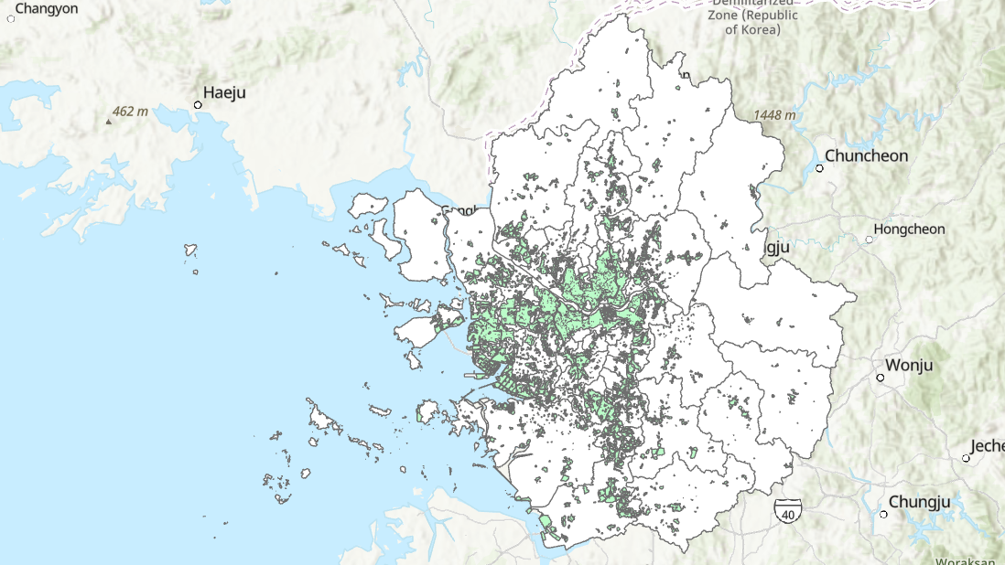
10
2025
Preprocessing
2025
Land Use Code Filtering
Green : Land Use Zone
White : Seoul Metropolitan Area boundary
Notes:
You can see the green areas we filtered as valid land use zones, and we made sure they all stay within the white boundary, which marks the Seoul Metropolitan Area.

Slide 10
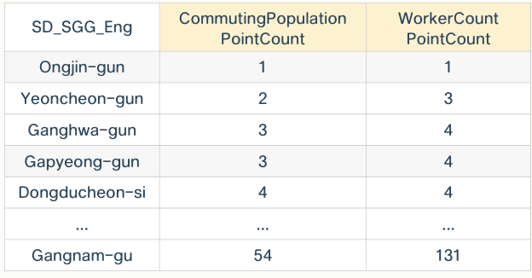
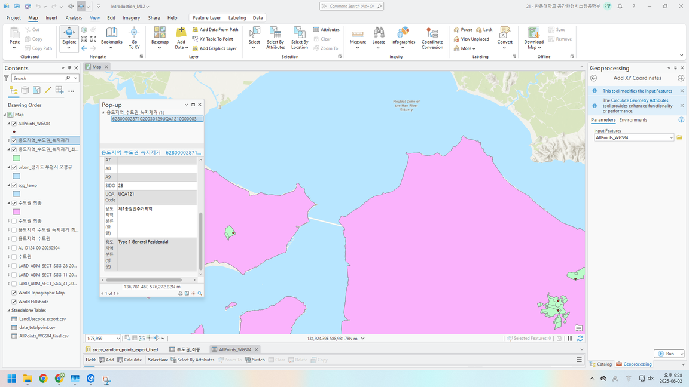
11
2025
Preprocessing
Point Placement Logic
Refer to the “00_PointCount” column per district to decide how many points to assign
Points are generated randomly but prioritized toward residential or business-dense zones
Example: If Gapyeong-gun has a count of 3, then 3 points are distributed within its boundary
Use ArcGIS Pro's “Create Random Points” tool within each district’s shapefile
Notes:
We assigned a point count to each region based on our preprocessed commuting and economic data.
Then, using the "Create Random Points" tool, we distributed these points randomly but within district boundaries.
Importantly, we ensured that points were only placed on valid land parcels, and gave priority to areas with dense residential or business zones.

Slide 11
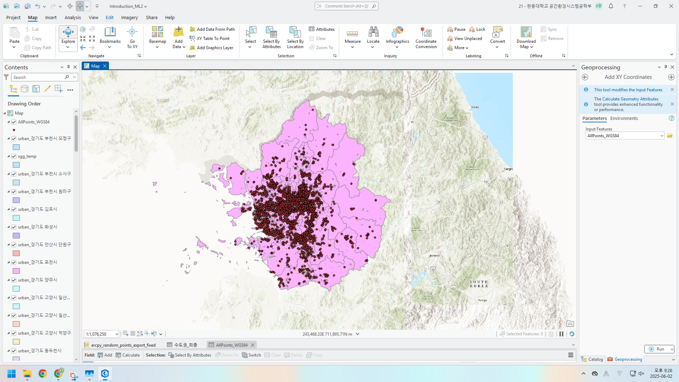
12
2025
Preprocessing
2025
GIS Processing View
In ArcGIS Pro, merged capital region shapefile with filtered land use zones
Points generated only on valid parcels
Final points verified via attribute table in export layer
Notes:
Finally, we used GIS to generate the actual point layer based on this logic

Slide 12
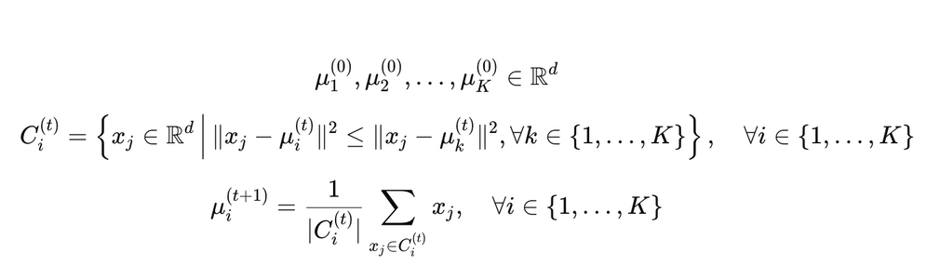
13
2025
Modeling
2025
K-Means Clustering
Scikit-learn library
Clusters: 100
Iterations: 1000
Random seed: 123
Manual adjustment of centroids in non-installable areas
Notes:
We applied the K-Means Clustering algorithm using the scikit-learn library. We set the number of clusters to 100, with a maximum of 1000 iterations, and fixed the random seed to 123 to ensure reproducibility.
However, during clustering, we observed that some cluster centroids were placed in non-installable areas, such as railways, roads, sea, or greenbelt zones. To address this, we manually adjusted those centroids to valid locations.

Slide 13
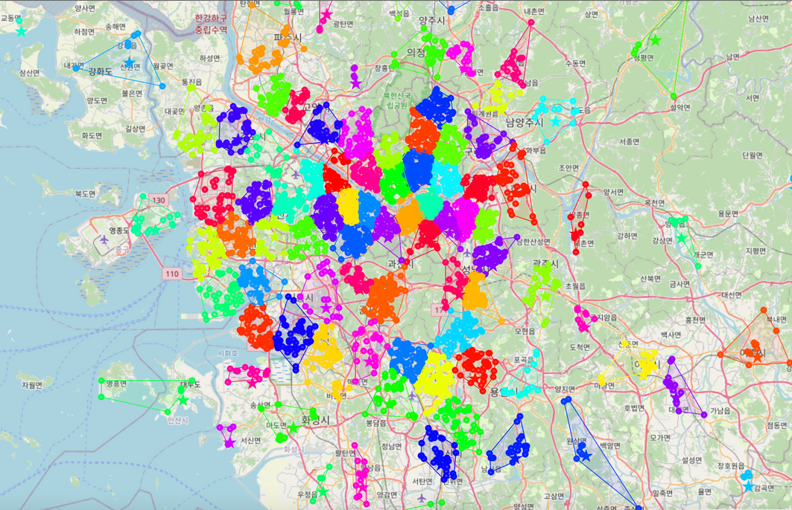
14
2025
Modeling
2025
Map Visualization
Assigned cluster labels to the original data
Visualized results using Folium
Displayed point locations, cluster boundaries, and centroids
Notes:
After clustering, we assigned the cluster labels to the original dataset. We then visualized the results on a map using the Folium library. For visualization, we displayed the locations of individual points, the cluster boundaries formed by these points, and the adjusted centroids. This helped us clearly understand the spatial distribution of the clusters.

Slide 14
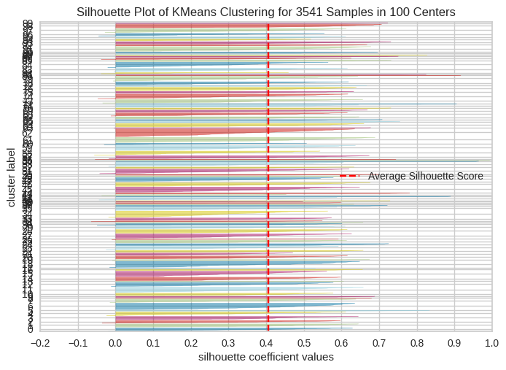
15
2025
Evaluation
2025
Silhouette Coefficient
Evaluated using silhouette coefficient
Average silhouette score ≈≈≈ 0.4
Possible improvements: fewer clusters or K-Means++ initialization
Notes:
Finally, we evaluated the clustering model using the silhouette coefficient. The silhouette coefficient measures how similar an object is to its own cluster compared to other clusters.
The average silhouette score was approximately 0.4, indicating moderate clustering quality. To further improve this score, we could consider reducing the number of clusters, or using algorithms like K-Means++ to improve the initial placement of centroids, leading to better clustering performance.

Slide 15
16
2025
Conclusion
Project Result
Need to Determine the Optimal Number of Clusters
Consider Alternative Models
It is necessary to identify the optimal number of clusters using the Elbow Method.
K-Means++, Weighted K-Means, K-Medoids,
DBSCAN, Mean-Shift, etc.
Improve Distance Calculation Methods
Consider Project Feasibility
In spatial clustering, it is important to consider the Earth's curvature when calculating distances. Therefore, models that use Haversine distance or geodesic distance instead of Euclidean distance should be considered.
South Korea is technically at war (armistice state), so the use of aerial vehicles within Seoul is not permitted.
Notes:
To conclude our presentation, we’d like to share the key findings and areas for improvement.
First, selecting the optimal number of clusters is essential for achieving better results.
While we used the Elbow Method, additional techniques such as Silhouette Scores or Gap Statistics could help produce more accurate outcomes.
Second, although we implemented the standard K-Means algorithm, other clustering models—such as K-Means++, Weighted K-Means, K-Medoids, DBSCAN, or Mean-Shift—may perform better, especially when accounting for spatial or density-based variations.
Third, our current model calculates distance using Euclidean geometry.
However, since our dataset includes real-world geographic locations, it’s more accurate to consider the Earth’s curvature.
In the future, we recommend using Haversine or geodesic distance to improve spatial accuracy.
Finally, we must consider real-world feasibility.
Due to geopolitical constraints—such as the ongoing armistice state in Korea—airspace usage over Seoul is currently restricted.
Although this is a hypothetical project, acknowledging these regulatory limitations is crucial for practical implementation.

Slide 16
17
2025
Thank you

Slide 17
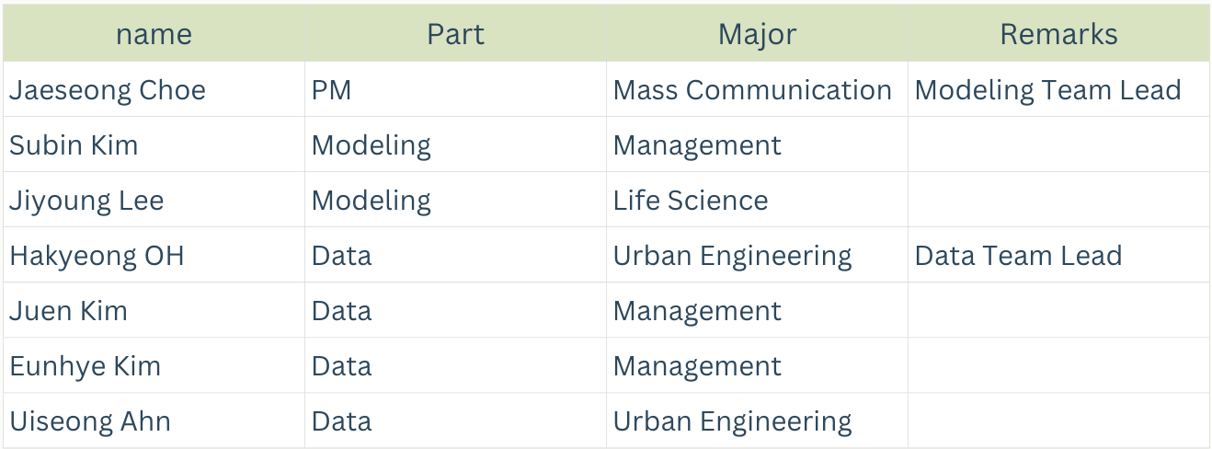
4
2025
Team Member
Notes:
Our team consists of 7 members with diverse academic backgrounds—from mass communication to urban engineering.
Here’s how we distributed our roles:
Jiyoung, Subin, and I focused on modeling and evaluation,
while Juen, Uiseong, Eunhye, and Hakyeong concentrated on data preprocessing.

